Slide 1
SolutionPack for EMC VMAX Watch4net Official Content v 1.0
2013-02-19 -- A.Lemay – Initial version

Slide 2
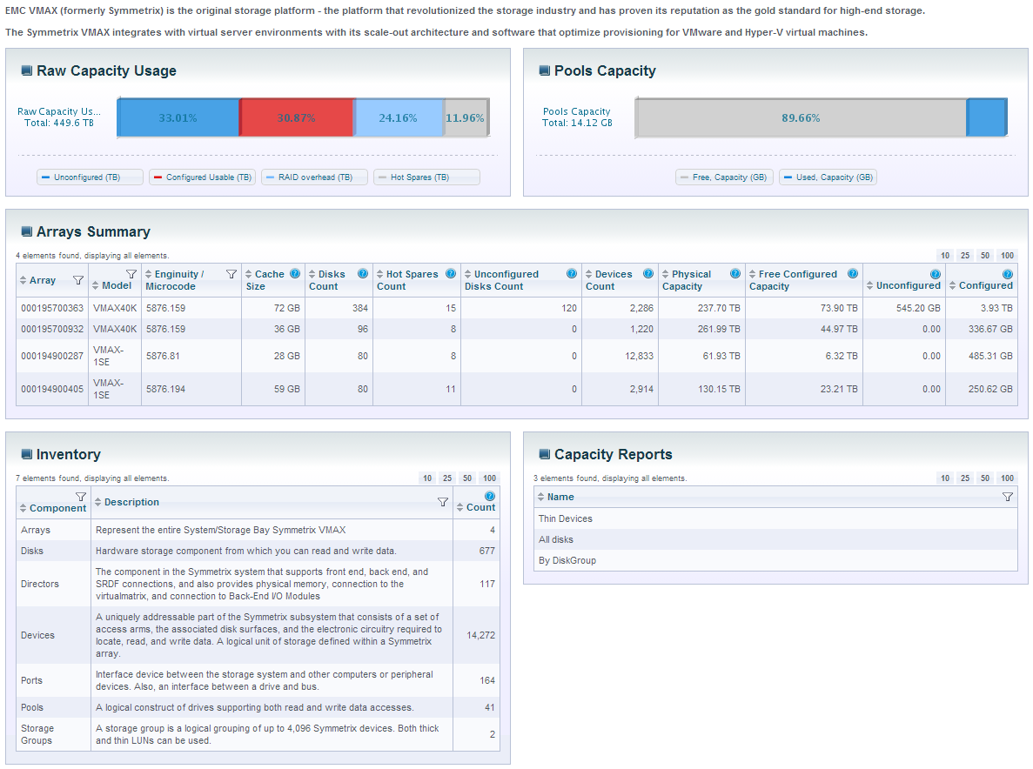
Global VMAX Infrastructure Dashboard
Overall Status with drill-down capability to see all information for that specific array
Inventory drill-down

Slide 3
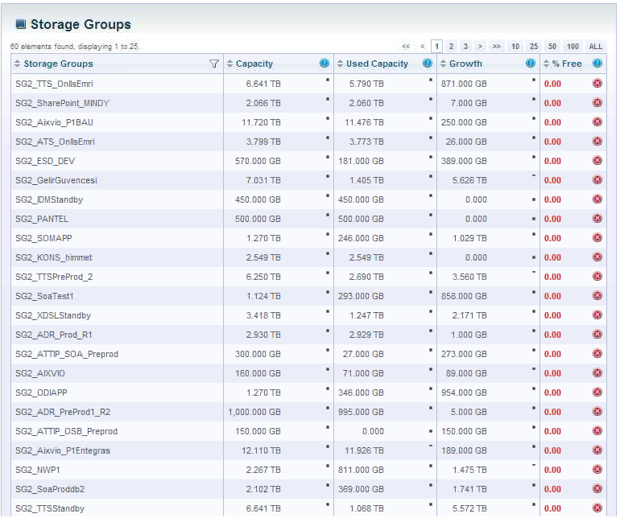
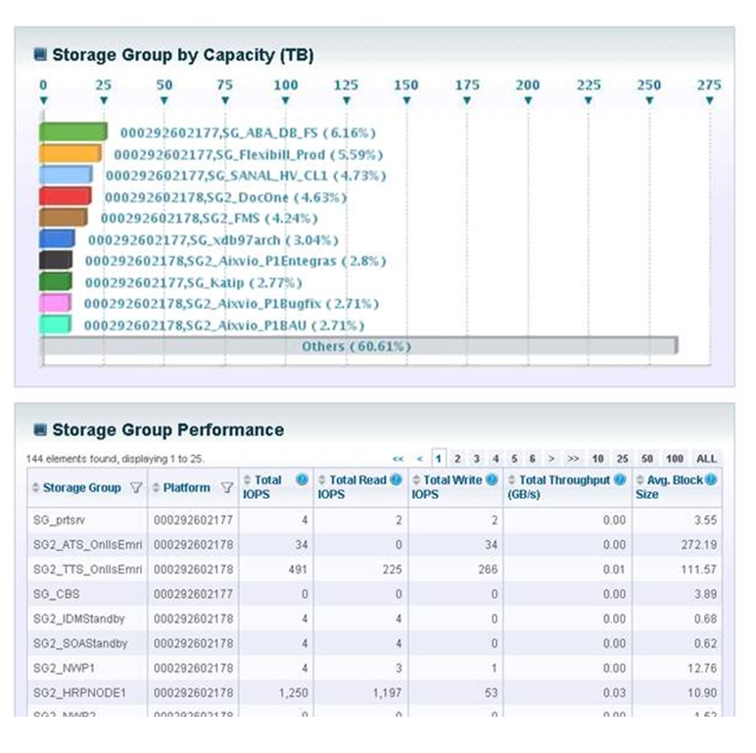
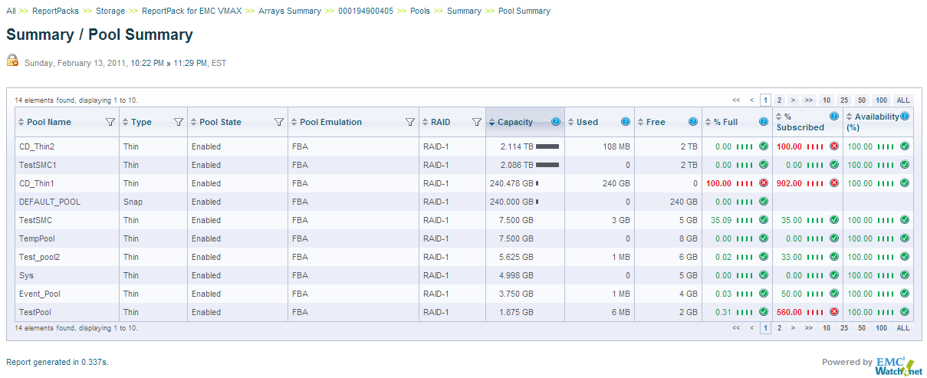
Storage Groups and Pools reporting

Slide 4
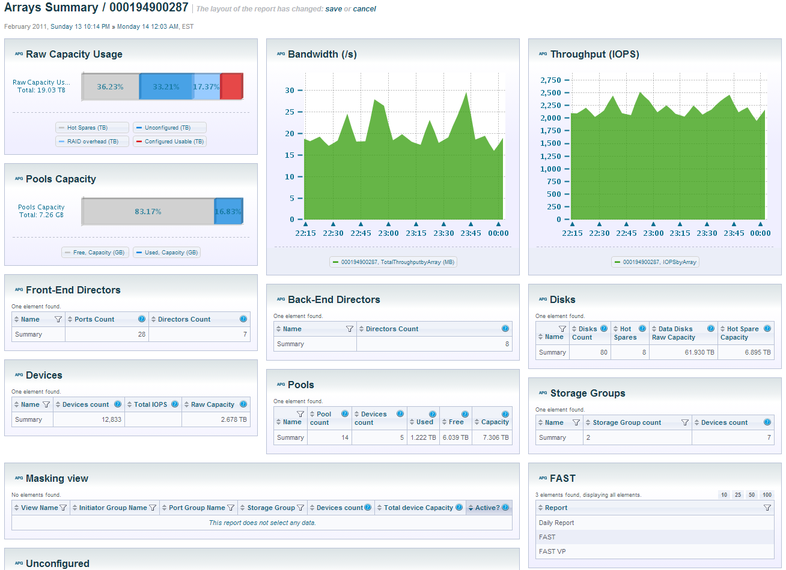
Array detailed analysis/reporting/inventory

